Slide 1
CSS Layout
IN712 Web 3

Slide 2
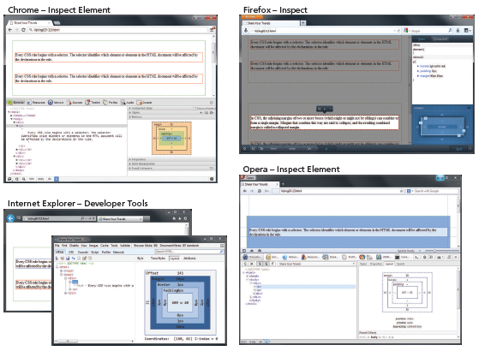
Inspecting CSS using developer tools within modern browsers

Slide 3
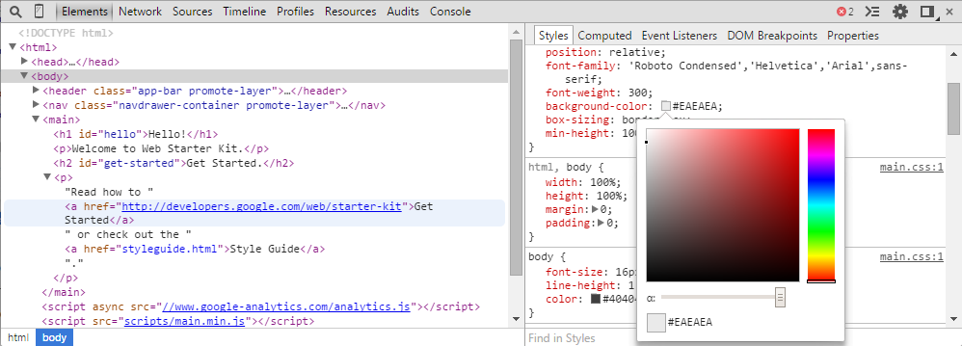
DevTools in Chrome
Ctrl+Shift+i
Ctrl+Shift+j: focus on the console

Slide 4
DevTools in Chrome
Provides lots of extremely useful debugging support for HTML, CSS and JavaScript
HTML, CSS and JavaScript have been traditionally very difficult to debug because you don’t really see them, you only see what the browser renders from them
We will see it with JavaScript working like a runtime debugger, but it is also very useful for CSS, even though there isn’t any runtime per se
Built directly into Chrome
Demo

Slide 5
Elements Layout
HTML elements can be classified according to their default layout (normal flow) into:
Block level elements
each element is contained in its own line
begin with a line break
Use the normal CSS box model
<p>, <div>, <h2>, <ul>, and <table>
In-line elements
Do not form their own blocks
Instead are displayed within lines
Normal text, <em>,<a>, <img>, and <span>

Slide 6
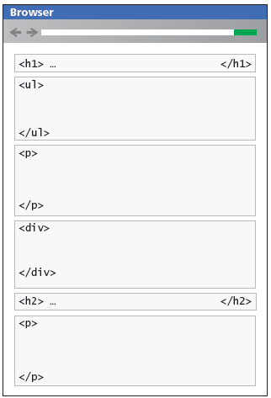
Block Elements

Slide 7
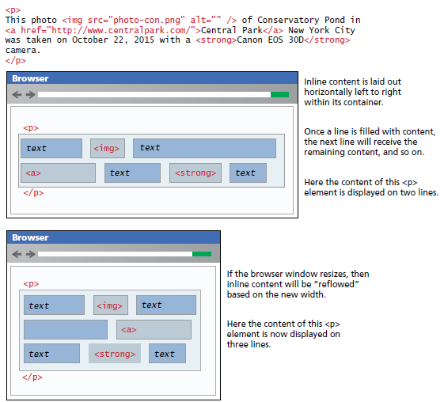
In-line elements

Slide 8
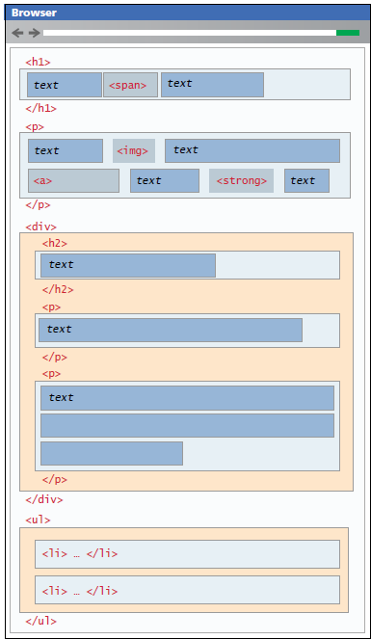
Block and in-line elements together

Slide 9
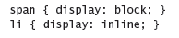
Changing the flow
It is possible to change whether an element is block-level or in line via the CSS display property.
These two rules will make all <span> elements behave like block level elements all <li> elements behave like in line elements (that is, each list item will be displayed on the same line)

Slide 10
Positioning elements
It is possible to move an item from its regular position in the normal flow
It is possible to position an item so it is always visible in a fixed position while the rest of the content scrolls
It is even possible to move an item outside of the browser viewport so it is not visible
The position property of CSS is used to specify the type of positioning

Slide 11
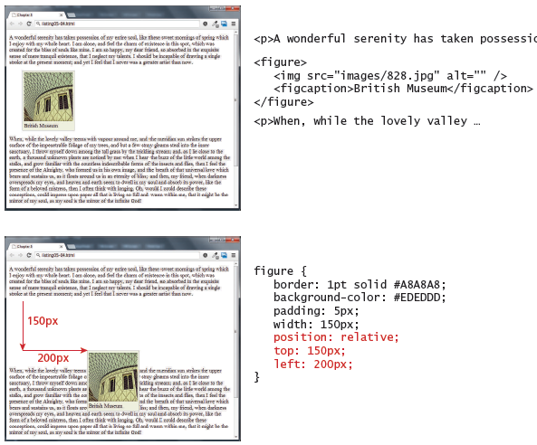
Static and Relative positioning
In relative positioning the element is offset with respect to its default positioning

Slide 12
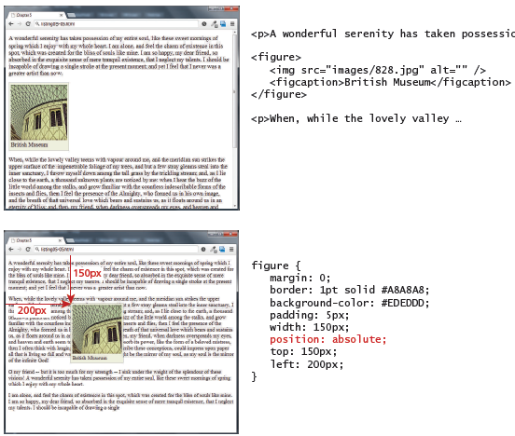
Absolute positioning
In absolute positioning the element is offset with respect to its 1st container element which is not static

Slide 13
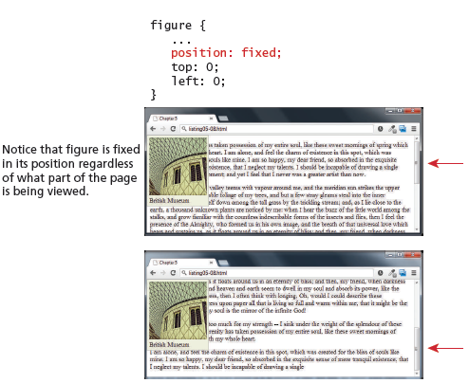
Fixed positioning

Slide 14
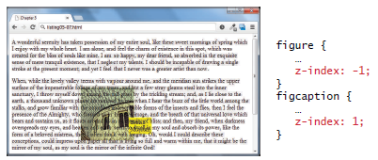
Z-index
It’s positioned element has a stacking order defined by the z-index property
Items closest to the viewer ( and thus on the top) have a larger z index

Slide 15
Positioning Demo
http://liveweave.com/VdckMG

Slide 16
Floating elements
An element can be displaced from its default position in the normal flow via their CSS float property
An element can be floated to the left or to the right of its container block
When an item is floated, it is moved all the way to the far left or far right of its containing block
The rest of the content is re-flowed around the floated element
A floated block level element must have a width specified
Otherwise it will implicitly filled the entire with of the containing block with no room available to flow content around the floated item

Slide 17
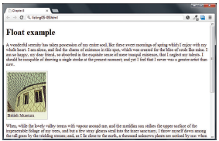
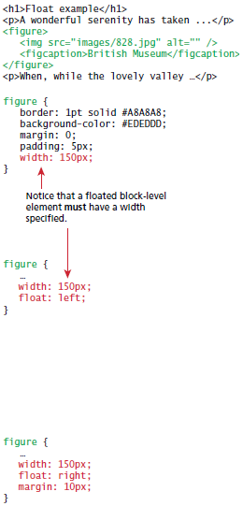
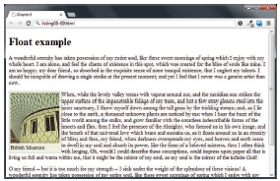
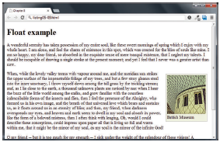
Floating elements

Slide 18
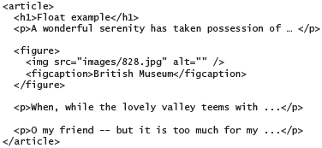
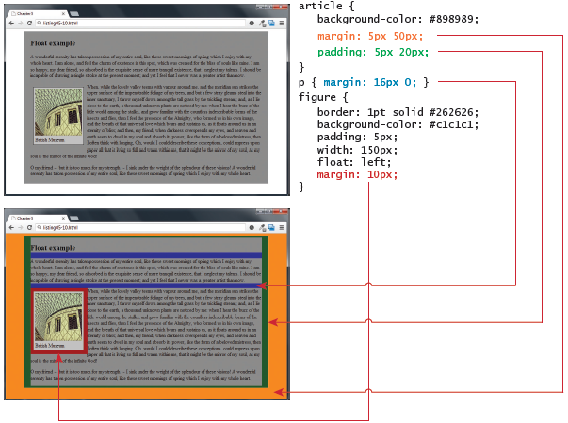
Floating elements

Slide 19
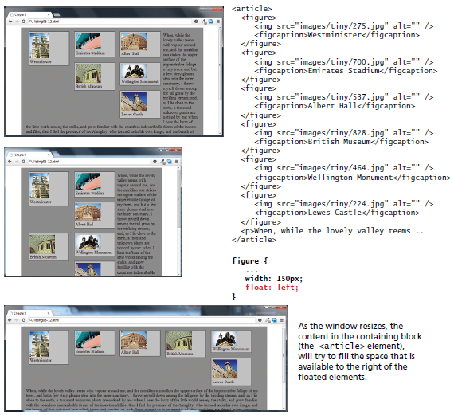
Problems with multiple floats

Slide 20
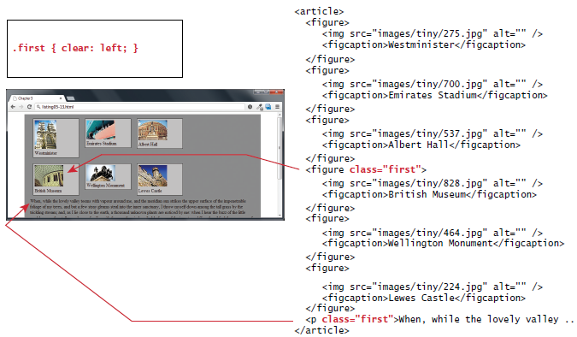
Using the clear property

Slide 21
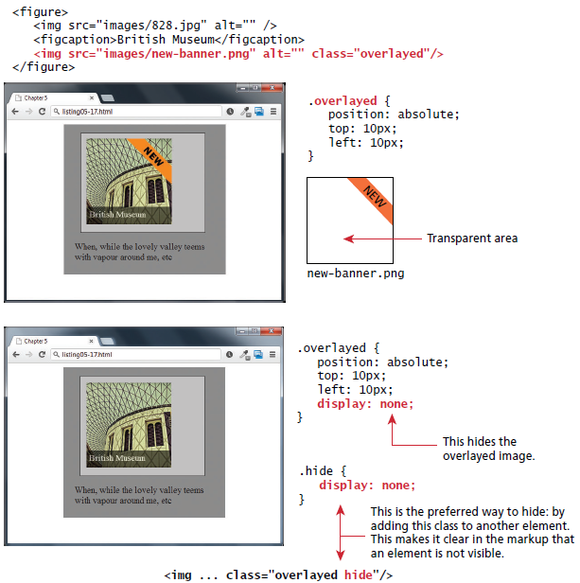
Using the display property

Slide 22
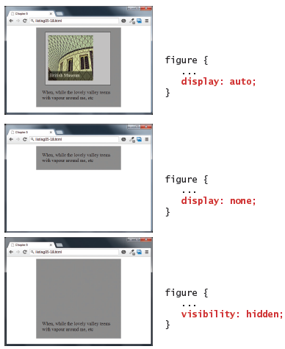
Comparing display to visibility

Slide 23
Creating Column Layouts - Floats

Slide 24
Creating Column Layouts – Absolute Positioning

Slide 25
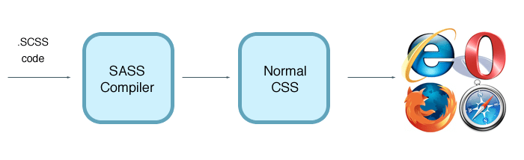
CSS preprocessors
CSS, as a language has its own feature set, which at times might not be enough to create a clean and reusable chunk of rules.
Not being able to reuse a collection of rules in multiple selectors
unavailability of variables which may lead to ambiguous pieces of data across the stylesheet.
To overcome most of these limitations, the concept of a preprocessor was born
Preprocessors offer an advanced way of writing CSS, which extends the basic functionalities. This advanced code is later compiled as normal CSS code using respective compilers (which depends on what preprocessor you are using), which the browser will understand.
CSS preprocessors:
Less
Sass
Turbine
switch CSS
Pcss

Slide 26
Demo
http://liveweave.com/VdckMG

